Slide 1


OWN | SHARE | EVOLVE

Slide 3

VISION
Your journey is our mission

Slide 4

VISION
Your time is our passion
Your journey is our mission

Slide 5
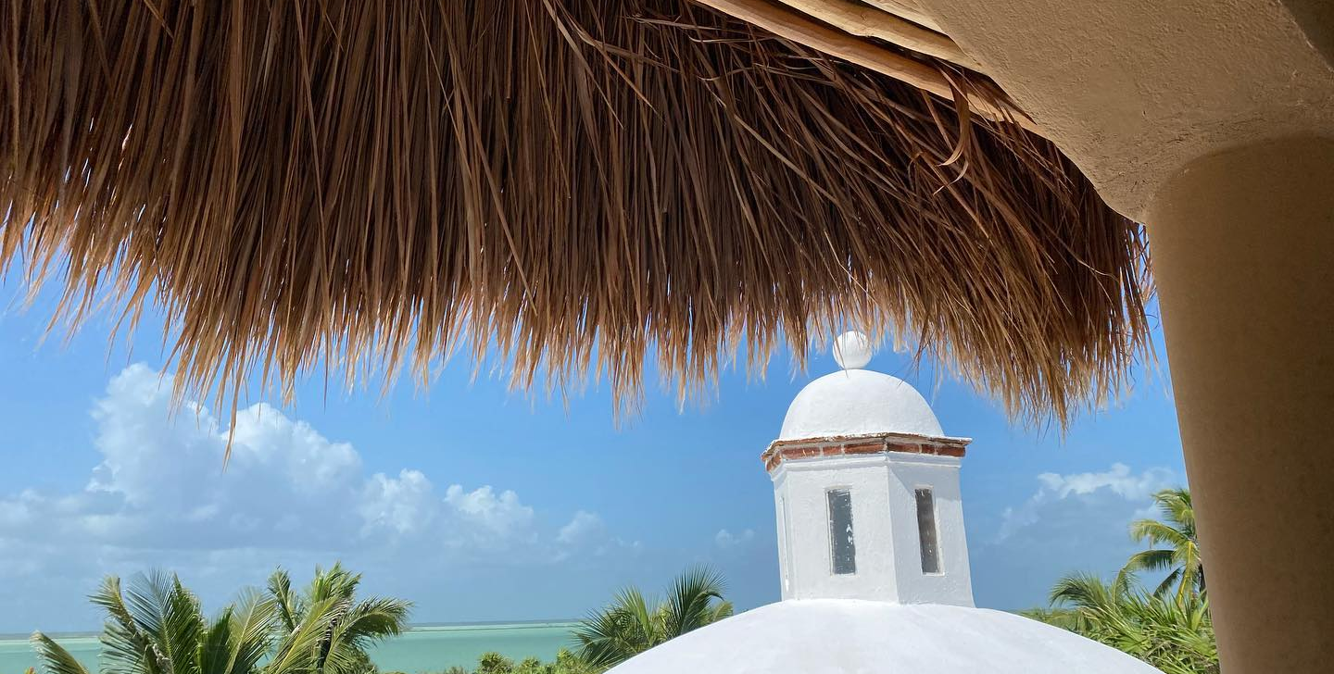
OUR MISSION
Extend your vacation
Experience the world

Slide 6


everyone works
on vacation
it should
feel like
home
PROBLEM
SOLUTION
some
cannot
they
should
Notes:
https://radsource.us/
https://www.rsna.org/news/2020/April/Telehealth-Surge
“Even our referring physicians are practicing a lot more telemedicine,” Dr. Kim said. “So as staff gets more used to teleradiology and to telemedicine in general — and it becomes more acceptable to hospitals, referring physicians and patients — it will become more of a standard way of practicing medicine.”

Slide 7
THE JOURNEY
The best office Please!
At the best locations!
With the best experiences!
Office classification system/DB
White-label App for Hotels++
Network service reliability guarantee
Network quality tool
AI driven Video classification:
desk features, chair ergonomics, window/view, office size & space design “secret sauce”
Deliverables
Office ranking algorythm
Prototype Labs - Condos, Hotel Rooms
Prototype Labs - Rugged/sustainable homes
Furniture desirablility score
Network reliability score
Connectedness score
App/Web development
Define VIVIM.home platform roadmap including services
Create white label services
Dev plan & cost layout details
Revenue
Path $$
Launch
VAYPLAY App
Launch first self-funded VIVIM.homes property

Slide 8






CUSTOMER MOMENT
Leisure Travel
Business/Sales Travel
Engineering Conference
Executive
Offsite
GEN-Z
Esports Olympics
Work While Travel (WWT)
0-10%
70-80%
20%-50%
60%-100%
I don’t work
I Play
Extend the vacation and work while traveling
Increased productivity
Have a safehaven
Peace of mind
Paving the road for the future
Impact
Remote Office Space Priorities
Learn what is needed by customer moment:
AI + Database + Algorithm + Customer tastes

Slide 9
There are several other variables that could be interesting to examine when evaluating potential home office locations. These variables can provide a more comprehensive view of the suitability of each location for remote work. Here are some additional variables to consider:
1. **Noise Level:** Assess the noise level in each location, which can impact concentration and productivity.
2. **Natural Light:** Evaluate the amount of natural light in each location as it can affect mood and focus.
3. **Internet Connectivity:** Consider the quality and reliability of the internet connection in each space.
4. **Proximity to Amenities:** Examine the proximity to amenities like the kitchen, restroom, and office supplies.
5. **Ergonomics:** Evaluate the ergonomic setup of each location, including the availability of a comfortable chair and desk.
6. **Privacy:** Assess the level of privacy in each location, which is important for confidential work.
7. **Access to Power Outlets:** Check the availability of power outlets for charging devices.
8. **View:** Consider the view from the workspace, as it can influence mental well-being.
9. **Temperature Control:** Evaluate the ability to control the temperature in each space for comfort.
10. **Distractions:** Identify potential distractions in each location, such as household noise or visual distractions.
11. **Storage Space:** Examine the availability of storage space for work-related items.
12. **Personalization:** Assess the ability to personalize the workspace with decorations or personal touches.
13. **Ventilation:** Consider the quality of ventilation in each space for fresh air.
14. **Work Hours:** Think about the hours during which you plan to work and whether the space is suitable during those times.
15. **Acoustics:** Evaluate the acoustics of each location, including echo or sound absorption.
These variables can provide a more nuanced understanding of the suitability of each location for remote work and help individuals make informed decisions about their home office setup based on their unique needs and preferences.

Slide 10
Understood, you want the "Focus" ratings to reflect the relative amount of family usage, with higher "Focus" ratings for spaces that are less commonly used and lower "Focus" ratings for common areas. Here's the updated table considering this perspective:
| Location | Focus | Bothering Others | Convenience | Appropriate | Comfort |
|--------------------|-------|-------------------|-------------|-------------|---------|
| Home Office | 5 | 1 | 5 | 5 | 5 |
| Living Room | 2 | 4 | 4 | 3 | 4 |
| Bedroom | 3 | 1 | 3 | 4 | 5 |
| Study | 4 | 1 | 4 | 5 | 4 |
| Basement | 3 | 3 | 3 | 4 | 3 |
| Kitchen | 2 | 5 | 4 | 3 | 3 |
| Outdoor | 3 | 4 | 5 | 4 | 4 |
| Attic | 3 | 3 | 3 | 4 | 4 |
| Garage | 2 | 3 | 3 | 3 | 3 |
| Dining Room | 3 | 4 | 4 | 3 | 4 |
| Sunroom | 4 | 3 | 3 | 4 | 4 |
| Home Theater | 4 | 3 | 3 | 4 | 5 |
| Guest Room | 3 | 2 | 4 | 3 | 4 |
| Library | 5 | 2 | 4 | 5 | 4 |
In this updated table, the "Focus" ratings are adjusted to match the relative amount of family usage. Spaces less commonly used for extended family periods have higher "Focus" ratings, while common areas and spaces used more frequently have lower "Focus" ratings.

Slide 11
Absolutely, it sounds like you want to assess and evaluate the quality of home office spaces within the vacation rental home market. In this context, the variables you're interested in will focus on determining the suitability and quality of these home office setups within vacation rental properties. These evaluations can be essential for travelers who need a functional and productive workspace while on vacation. Some of the variables to consider might include:
1. **Workspace Layout:** Assess the layout of the workspace within the vacation rental, including the availability of a dedicated desk or table for work.
2. **Furniture Quality:** Evaluate the quality of the desk, chair, and any other furniture in the workspace.
3. **Internet Speed:** Test the speed and reliability of the internet connection to ensure it meets the needs of remote work.
4. **Workspace Location:** Consider the location of the workspace within the rental property for privacy and reduced distractions.
5. **Noise Levels:** Assess the noise levels in and around the workspace to determine if it's conducive to work.
6. **Lighting:** Evaluate the quality and quantity of lighting in the workspace.
7. **Privacy:** Determine the level of privacy and separation from other living areas.
8. **Workspace Amenities:** Check for amenities like power outlets, charging stations, and any additional equipment like printers or scanners.
9. **Ergonomics:** Assess the ergonomic setup of the workspace to ensure it's comfortable for extended work periods.
10. **Storage Space:** Consider the availability of storage for work-related items.
11. **Workspace Size:** Determine the size of the workspace to ensure it's adequate for work.
12. **Accessibility:** Evaluate how easy it is to access the workspace within the rental property.
13. **Workspace Customization:** Consider if the workspace allows guests to personalize it for their work needs.
14. **Feedback from Previous Guests:** Check for reviews and feedback from previous guests regarding the quality of the home office setup.
By assessing these variables, you can provide potential renters with a clear understanding of the quality and suitability of the home office space in vacation rental properties. This information can help travelers make informed decisions when booking accommodations for remote work while on vacation.

Slide 12
Certainly, for a vacation rental home office assessment app, an MVVC (Model-View-ViewModel-Controller) architecture would be a suitable choice. This architecture separates the app into different components, making it easier to manage and maintain. Here's a simplified proposal for the MVVC schema fitted to this project:
1. **Model:**
- The Model represents the data and business logic of the application. In this context, the Model could consist of:
- **Property Data:** Information about vacation rental properties, including features, amenities, and variables like those mentioned in our discussions.
- **User Preferences:** User-specific preferences and requirements for a home office space.
- **Ranking System:** A structured representation of variable rankings and desirability criteria.
2. **View:**
- The View is responsible for the user interface and presenting information to the user. For this app, the View could include:
- **Property Listings:** Displaying available vacation rental properties with detailed information.
- **Property Details:** Providing more information about each property, including its home office space.
- **User Profile:** Allowing users to set their preferences and criteria.
- **Ranking Interface:** Displaying rankings for each variable in a user-friendly manner.
3. **ViewModel:**
- The ViewModel acts as an intermediary between the Model and the View. It transforms data from the Model into a format that can be displayed in the View. For this app, the ViewModel could:
- Calculate overall ratings for properties based on user preferences and the variable rankings.
- Present the results in a format suitable for display in the View.
- Handle user interactions and filter or sort property listings based on user preferences.
4. **Controller:**
- The Controller manages user interactions and coordinates the flow of data between the Model, View, and ViewModel. In this app, the Controller could:
- Respond to user input, such as setting preferences, filtering properties, or ranking variables.
- Communicate with the ViewModel to retrieve and update property data.
- Update the View to reflect user preferences and the assessment results.
5. **Data Store:**
- The app would require a data store to manage property information, rankings, and user preferences. This could be a database or an API to access and store data.
6. **Ranking System Configuration:**
- Provide a way for users to customize the ranking system and variable desirability based on their individual preferences.
This MVVC schema allows for a clear separation of concerns and modular components, making it easier to extend and maintain the app. Users can set their preferences, and the app can provide them with a ranked list of vacation rental properties based on the suitability of their home office spaces. It also allows for user customization of the ranking system to match their unique requirements.

Slide 13
ROUTES TO MARKET
Residential Vacation Rentals
Luxury
(Hotels, Castles, Gated)
Hotels
Vacation Condos

Slide 14

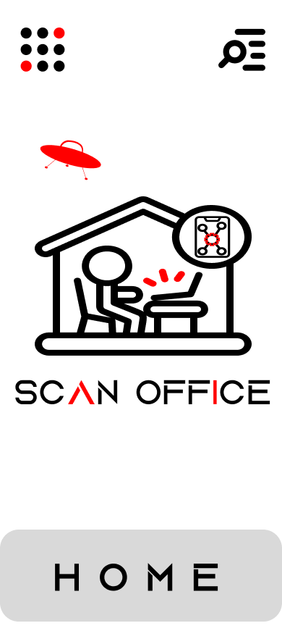

The Vacation Office App
MOCKUP
(CONCEPTUAL ONLY)

Slide 15
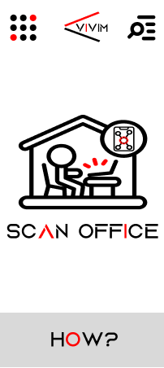
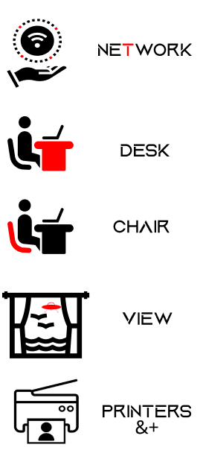

CATEGORIZE & RANK THE REMOTE OFFICE
FIND A LONGER VACATION
START
SELECT SCAN
AUTO DETECT
FIND RENTALS WITH THE BEST OFFICE

Slide 16
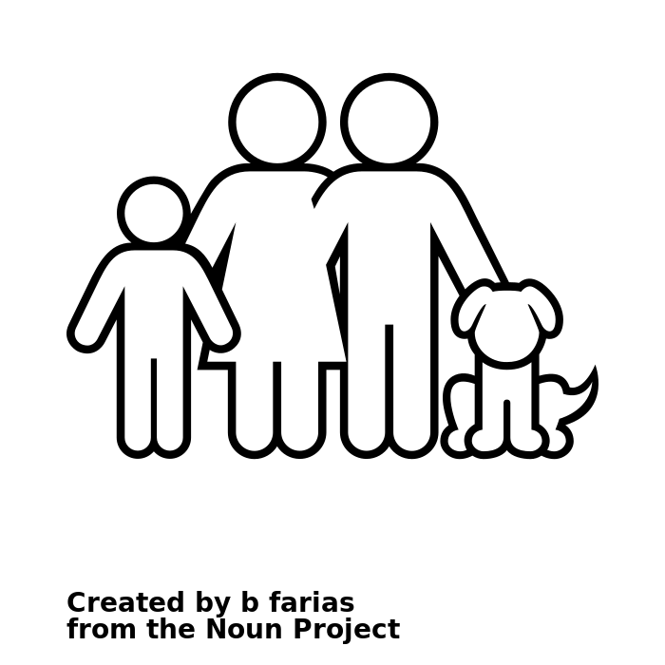

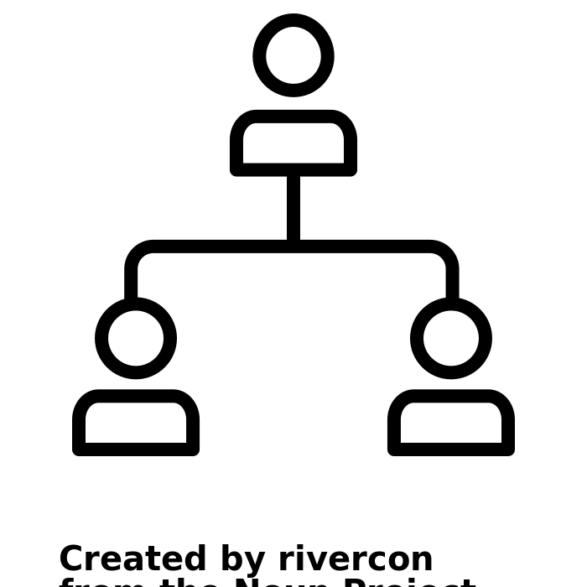

EVERYONE BENEFITS
FAMILIES
EMPLOYEES
EMPLOYERS
INVESTORS
….
Learn more about the future of work while travel
Help design the ideal remote office space
Engagement
Phase-0
Seed
+Time traveling together
+Quality family time
+Time at destinations
Peace of mind
Confidence
+Productivity
+Employee retention
$ Upselling
New tier of service
Longer stays
Phase-1
Launch
++Time traveling together
++Quality family time
++Time at destination
++Productivity
++Employee retention
$$ New customer tier
Longer stays
New 3rd party services
Phase-2
Build

Slide 17
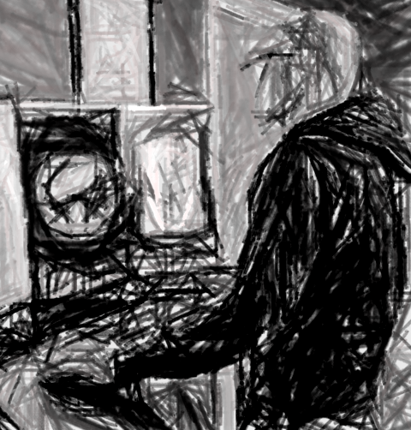

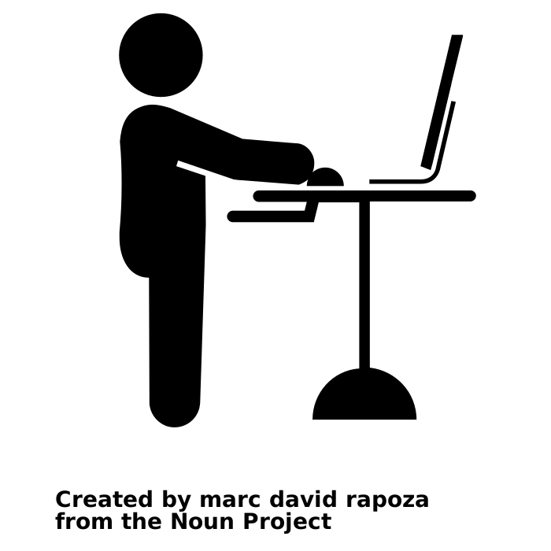
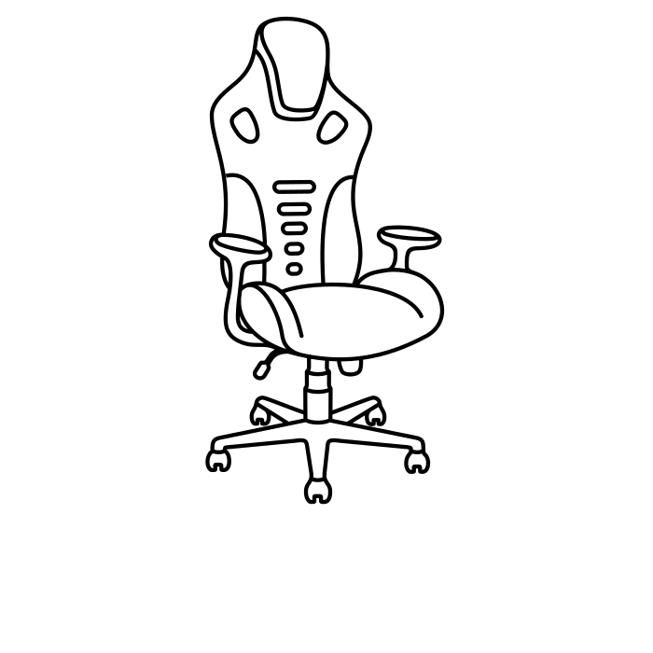
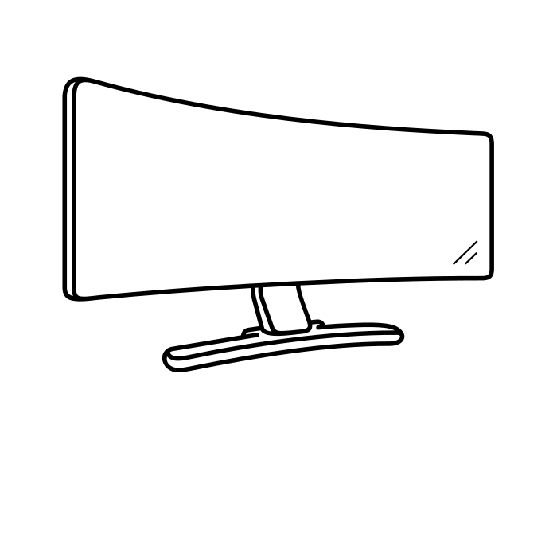
AVATAR CUSTOMER
Network Service
Reliability
Standing Desk
GEN-Z
Risk averse
Highest WFH requirements
Paving the road for Telehealth
24/7/365 coverage
Already a significant player
Ultra High-Def
Monitor
Ergonomic Chair
Notes:
https://radsource.us/
https://www.rsna.org/news/2020/April/Telehealth-Surge
“Even our referring physicians are practicing a lot more telemedicine,” Dr. Kim said. “So as staff gets more used to teleradiology and to telemedicine in general — and it becomes more acceptable to hospitals, referring physicians and patients — it will become more of a standard way of practicing medicine.”

Slide 18
New Market New TAM
Chart Area = Time Spent
Traditional
Office
Home
Office
Co-working
% of People
Workspace as a key differentiator
Across all vacation accommodation types
Potential Market
(Phase-3)
Hotels
Current
Market
Vacation Rentals
Work
Leisure
Work While Travel (WWT)
Full Time = 100%
Chart area = Time

Slide 19
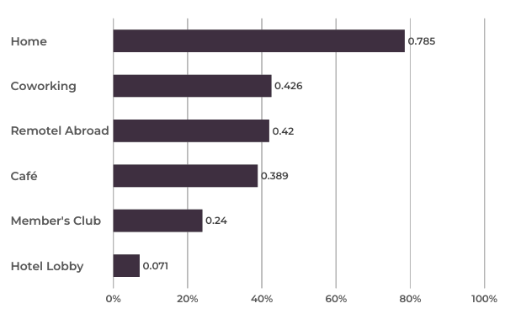
A REAL MARKET
DATASOURCE: HUBBLEHQ

Slide 20
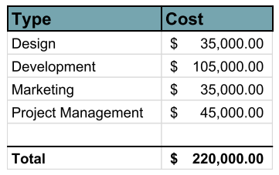
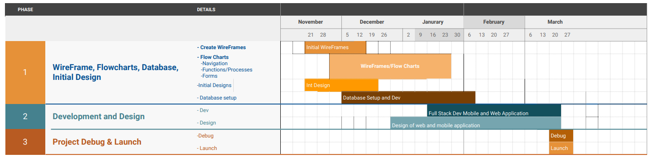
APP DEV
Draft Budget and Timeline
Project Manager: Patrick Fraser
->Highly variable depending on launch strategy and Phase 1 finally approved objective
->Includes $6K/month salary for Owen

Slide 21
LEVEL-1 Project Plan
Seed Funding Day -> Day-0 Begins
Design / Flow
Initial Wire Frame
FlowCharts
Application Design
Marketing Campaigns
Digital Presence
Day-0
FlowCharts
Template Tests Featured Design Review
Navigation Flow Chart
Function Flow Charts
Navigation Flow Chart
Database Flow Charts
Application Design
Branded Design
Season Designs
Eblast Templates
Form Design
Featured Page Design
Advertisement/Banner area design
Google Ads
Linked In Ads
SocialMedia Ads
Facebook
LinkedIn
Instagram
Twitter
++
App Development
Database Dev
Functionality and Actions
Android and IOS
Develop Functions and Engagement
Day-0
Database Architecture
Triggers and Actions
Unique user id and storage
Apply Algorithm
Open Ended Design
Advanced Search Filter
User Tools
Service Tools
Reviewing System
Gallery Functions and Interaction
Video Functions and Interaction
Cross Platform Communication
Open API
Compatible Database
Facebook
LinkedIn
Instagram
Twitter
++

Slide 22
LEVEL-1 Project Plan
Seed Funding Day -> Day-0 Begins
Functions and Engagement
Photo and Video Galleries
Client Profiles
User Permission
Day-0
User Profiles
Photo and Video Galleries
Client Gallery
User Album
Featured Gallery
Complete editing capabilities
PW Change
Notification Settings Referral
User Info
Profile Image
PW Change
Notification Settings
Referral
User Info
Profile Image
Google Ads
Linked In Ads
SocialMedia Ads
Automated Revenue Systems
Financial Model Design
Client Profiles
User Permission
Day-0
User Profiles
Criteria design
As a serviceHotel Mode
Complete editing capabilities
PW Change
Notification Settings Referral
User Info
Profile Image
PW Change
Notification Settings
Referral
User Info
Profile Image
Google Ads
Linked In Ads
SocialMedia Ads

Slide 23
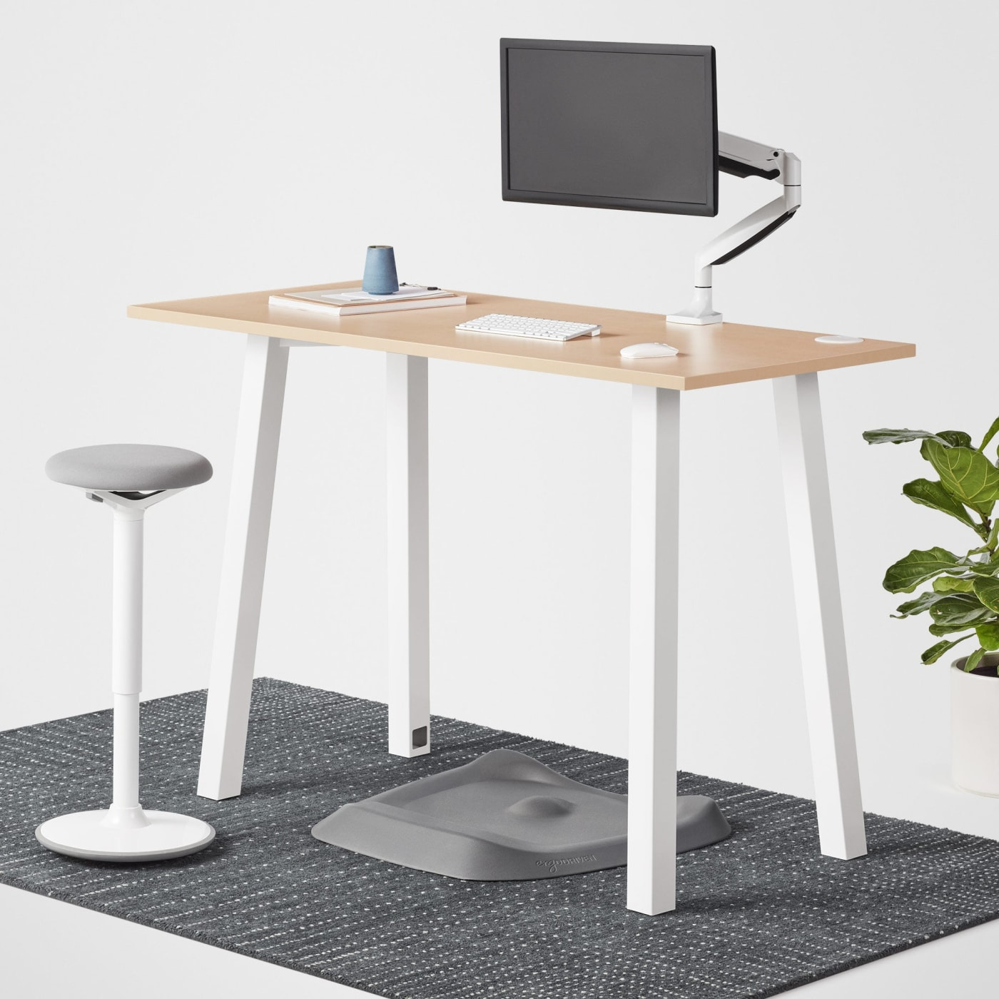
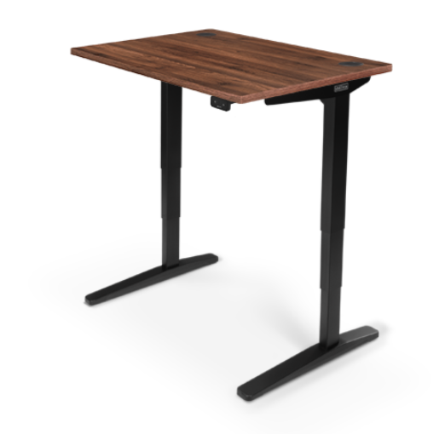
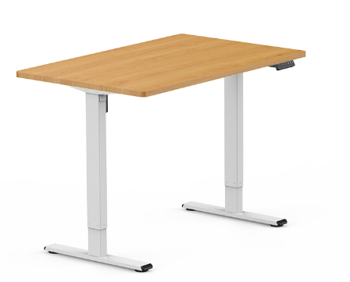
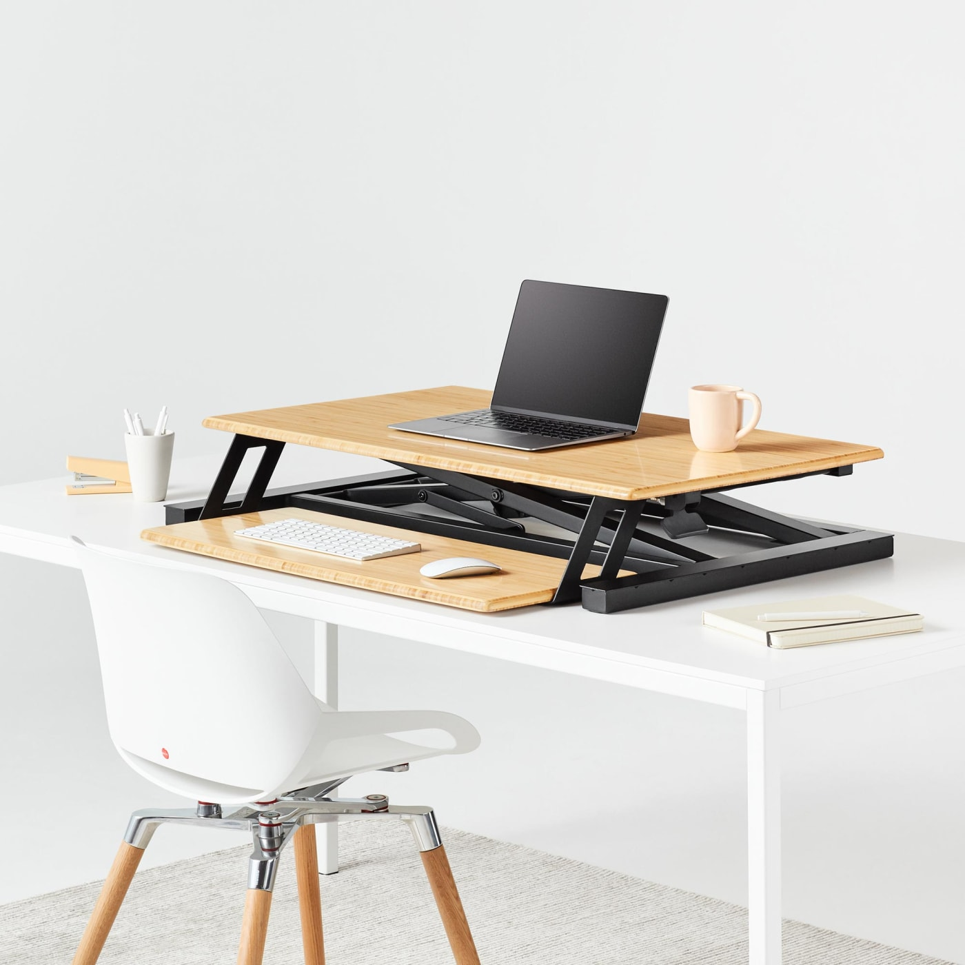
DATABASE
EXAMPLE :: OFFICE DESKS
Static Standing Desk
Mechanical
Electric
Converter
KEY FEATURES
XYZ
LKASDJF
ASDIFJ
ASLDKFLKASD
ALSKDJFKLASJDF
KEY FEATURES
XYZ
LKASDJF
ASDIFJ
ASLDKFLKASD
ALSKDJFKLASJDF
KEY FEATURES
XYZ
LKASDJF
ASDIFJ
ASLDKFLKASD
ALSKDJFKLASJDF
KEY FEATURES
XYZ
LKASDJF
ASDIFJ
ASLDKFLKASD
ALSKDJFKLASJDF

Slide 24
REVENUE MODEL

Slide 25
CATEGORIZE & RANK THE REMOTE OFFICE
FIND A LONGER VACATION
START
SELECT SCAN
AUTO DETECT
FIND RENTALS WITH THE BEST OFFICE

Slide 26

$632B TAM
THE MATH
Expand existing demand
New demand/market class

Slide 27
Leisure Accommodations Market 2021
+$?B
World
LEISURE ACCOMODATIONS
11.3% CAGR
$632B
11.3% CAGR
RISK AVERSE WFH TRAVELERS
BETTOR WWT
OFFICES
USA
+LONGER STAYS – (PHASE 2)
A +1% change in LoS = $6.3B
$174B
4.7% CAGR
+$?B
+NEW BOOKINGS – (PHASE 3)
+1% increase
in LoS = $6.2B
WWT = Work While Travel
LoS= Length of Stay
CAGR: 2021 - 2030
Notes:
https://www.alliedmarketresearch.com/trav
https://www.statista.com/outlook/mmo/travel-tourism/united-statesel-accommodation-market
The average trip will likely be longer in length (5-7 nights in 2022, compared to an average of 3.8 nights in both 2020 and 2021).
https://www.prnewswire.com/news-releases/evolves-2022-travel-trends-forecast-travel-returns--but-expectations-have-changed-301401609.html

Slide 28
REVENUE PATH

Slide 29

THANK YOU!!
We cannot wait to host your pitch sessions in one of our vacation rental offices!

Slide 31
backup

Slide 32
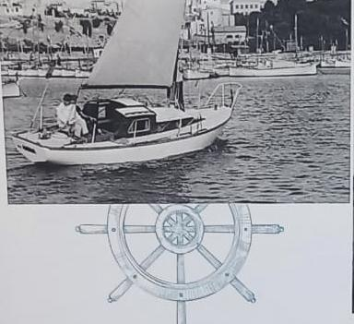
+
GENESIS
DETAILED
Experience at scale
12 years holding senior globally and strategically important functions gave Owen a full dose of exactly how complex it is to build, manage and operate at the Fortune 10 scale. Most notably, global strategic alliances.
12 Years working from home
Owen joined Hewlett-Packard in 2010 when a WFH journey began. Living and breathing the impacts of a global always-on enterprise. The genesis of VIVIM comes from these years, exploring the world with his Ex-wife as they dreamed of bringing to life empty Castles. They envisioned the world where families and friends would once again live work and breath in these magical spaces, so their memory could once again be living for the living. He stands more convinced today than ever, concentration of wealth is so large we have empty castles, yachts and hotels while having people homeless on the streets of those who feel responsible to solve the world’s problems. The backyard, this became the motivation and inspiration for VIVIM. The world is a neighborhood.
O
Dn. Antonio Servera Avellans
A history of travelers
Born in Mallorca and returning at the age of, Owen spent his formative youth living and breathing the industry. From hotel rounds with his grandfather to trespassing on any hotel grounds that blocked his entrance to the sea, there was no distinction between these spaces and any other. A family steeped in the history of international hosting as the islands and beach tourism blossomed shaped his tastes, appreciation and value of how we spend and design our quality of time, alone, with others and with nature.

Slide 33
+
GENESIS
DETAILED
Experience at scale
12 years holding senior globally and strategically important functions gave Owen a full dose of exactly how complex it is to build, manage and operate at the Fortune 10 scale. Most notably, global strategic alliances.
12 Years working from home
Owen joined Hewlett-Packard in 2010 when a WFH journey began. Living and breathing the impacts of a global always-on enterprise. The genesis of VIVIM comes from these years, exploring the world with his Ex-wife as they dreamed of bringing to life empty Castles. They envisioned the world where families and friends would once again live work and breath in these magical spaces, so their memory could once again be living for the living. He stands more convinced today than ever, concentration of wealth is so large we have empty castles, yachts and hotels while having people homeless on the streets of those who feel responsible to solve the world’s problems. The backyard, this became the motivation and inspiration for VIVIM. The world is a neighborhood.
O
Dn. Antonio Servera Avellans
A history of travelers
Born in Mallorca and returning at the age of, Owen spent his formative youth living and breathing the industry. From hotel rounds with his grandfather to trespassing on any hotel grounds that blocked his entrance to the sea, there was no distinction between these spaces and any other. A family steeped in the history of international hosting as the islands and beach tourism blossomed shaped his tastes, appreciation and value of how we spend and design our quality of time, alone, with others and with nature.

Slide 34
LIFECYCLE
Evolve
Scale
Die
Network Effects
Iterative Learning –
database refinement
Algorythm refinement
Apps improvements
Service model design
Beta
Iterative Learning –
database refinement
Algorythm refinement
Apps improvements
Service model design
Adoption

Slide 35
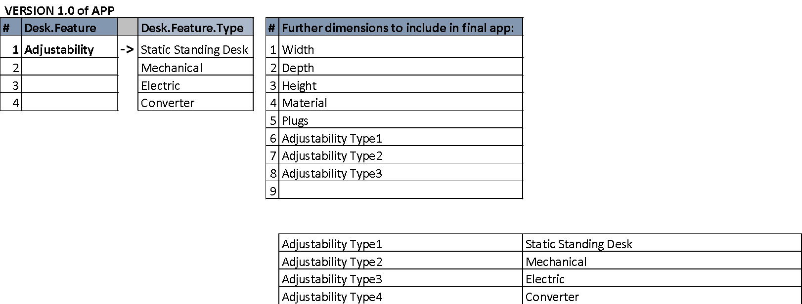
A DATABASE POWERED BY NEXT GEN-AI
AI powered relational database adjusting data relationships on update process.

Slide 36
The rise of the Vacation Office
100% Current Office Space
Traditional
Office
Home
Office
Co-working
Home Office is already a significant player in the Vacation Rental Market
Worskpace will be a key differentiator
% of People
Market gap
100% Current Vacation
Market
Hotels
Vacation Rentals
Work
Leisure
50% WWT
0% WWT
Work While Travel (WWT)
Full Time Working = 100%
*Chart AREA = % Time

Slide 37
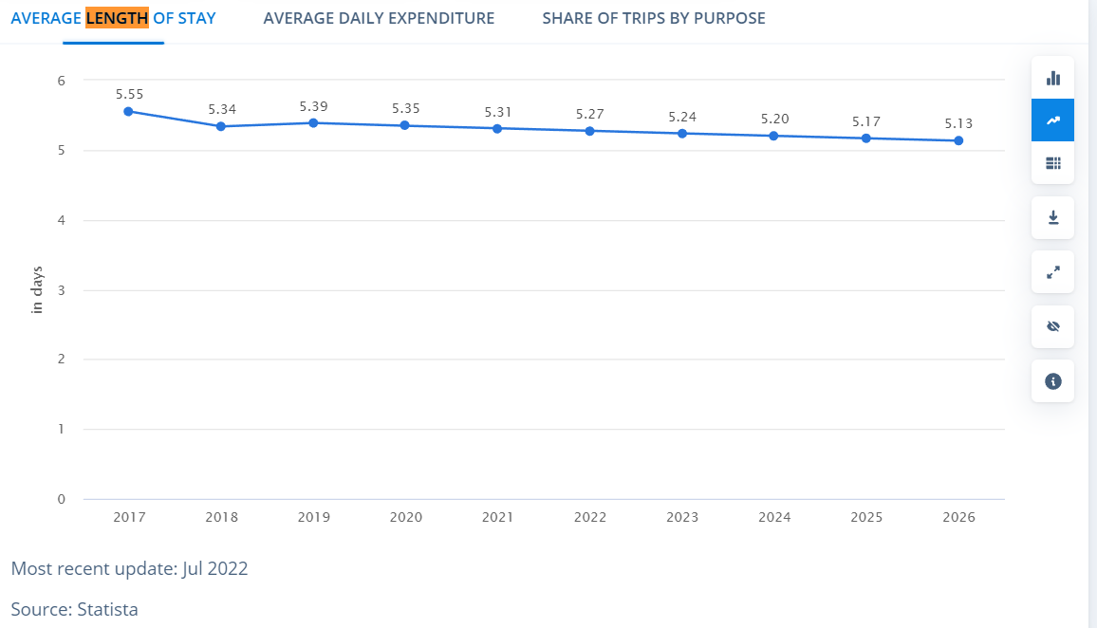

Slide 38
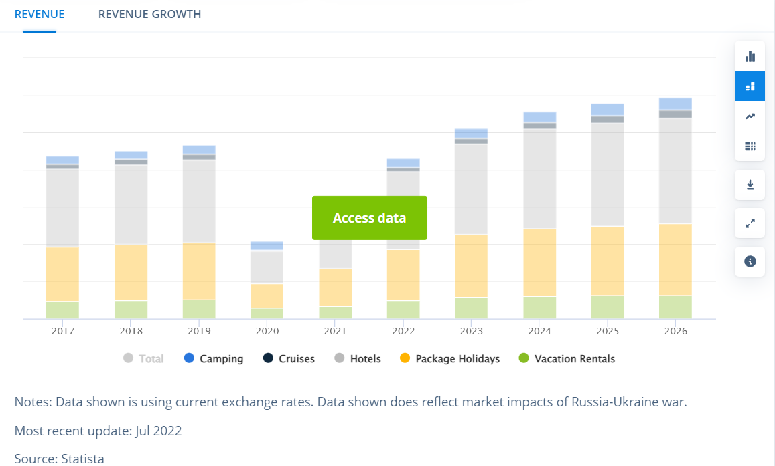

Slide 39
OPORTUNITY - 2021
$B
$632B
11.3% CAGR
LEISURE ACCOMODATIONS
11.3% CAGR
World
$B
THE RISK AVERSE
+LONGER STAYS – (PHASE 2)
EUROPE
39%
$B
$B
+NEW BOOKINGS – (PHASE 3)
11.3% CAGR
$B
Notes:
https://www.ustravel.org/research/monthly-travel-data-report
https://www.alliedmarketresearch.com/travel-accommodation-market

Slide 40
Internet and home-office quality at vacation rentals reduces the number of days and number of customers who choose to take extended vacations.
PROBLEM STATEMENT
Expand existing demand
New demand/market class
Notes:
https://radsource.us/
https://www.rsna.org/news/2020/April/Telehealth-Surge
“Even our referring physicians are practicing a lot more telemedicine,” Dr. Kim said. “So as staff gets more used to teleradiology and to telemedicine in general — and it becomes more acceptable to hospitals, referring physicians and patients — it will become more of a standard way of practicing medicine.”

Slide 41
Insight #4: Travelers Over 40 Are Driving the Remote Work Travel Trend (Longer Stays)
Evolve looked at behavioral shifts and differences between younger travelers (defined as those under 40-years-old) and more experienced travelers (those above 40-years-old).
Travelers over 40 are almost four times as likely to book trips longer than one week – and over five times more interested in taking trips exceeding two weeks – than those under 40. This indicates that travelers over 40 are more likely to plan extended stays/work remote trips. Younger travelers are showing a clear preference for shorter trips (3-4 nights in length; 54 percent of under 40 respondents).
Travelers over 40 are more likely to travel with their significant other or plan multigenerational trips, whereas those under 40 are more interested in traveling with a group of friends or solo.
https://www.prnewswire.com/news-releases/evolves-2022-travel-trends-forecast-travel-returns--but-expectations-have-changed-301401609.html
The GBTA study also found that millennials were the most likely cohort to extend a business trip for leisure, with 48% of millennial respondents having done so in the last year. During the same timeframe, 33% of Gen Xers and 23% of Baby Boomers extended their business trips.
https://hoteltechreport.com/news/bleisure

Slide 42
Airbnb: Our Guests Stay Longer And Spend More Than Hotel Guests, Contributing $56M To The San Francisco Economy
Ryan Lawler@ryanlawler / 12:01 AM PST•November 9, 2012
https://techcrunch.com/2012/11/09/airbnb-research-data-dump/

Slide 43
Essential Travel Statistics by Age Group
Most people who worked in America took a total of 17.2 days of vacation a year.
70% of Millennials preferred to stay in a hotel or motel during their travels.
Those part of Gen Z use online travel agencies to plan and book their trips, and 43% of them stay for 29 days.
The total amount spent by Baby Boomers on travel reached $157 billion last year.
Millennials and those who belong to the Gen Z age group spend $60 a day on travel, averaging $3,500 spent while traveling.
35% of Millennials choose stay in luxury resorts when traveling.
Social media factors into the vacation decisions of 90% of Gen Z travelers.
Most Millennials take 35 vacation days a year and prefer to travel for all or most of the time they are not working.
Gen X travels the least at 29 days, followed by Gen Z.
40% of Millennials and their friends are planning to travel in 2020.
Most Gen Z travelers seek adventure during their trips.
A quarter of people who belong to the Gen Z age group spent a quarter of their travel budget on flights.
83% of Millennials want all-inclusive vacation packages.
More Millennials (77%) use the entirety of their vacations for travel as opposed to 62% of Baby Boomers.
https://www.thewanderingrv.com/travel-statistics-by-age-group/

Slide 44
Which Age Group Spends the Most on Leisure Travel in the United States?
25% of Gen Z travel budgets are spent on air travel.
The vast majority of those who belong to Gen X look for the best deals before booking a vacation.
57% of boomers determine their trips based on their budgets, compared to 81% of those who belong to Gen Z.
Tours and sightseeing make up 13% of Gen X vacation budgets.
Boomers spend at least $1,865 per person on summer vacation travel.
Boomers spent a total of $6,600 or more on trips in 2019.
A one-week vacation costs 56% of Millennials between $500 – $1,000.
Millennials spend $1,373 per person as an average on summer vacation travel.
Gen X spends the most on summer vacations, at $2,628.
The age group most likely to borrow money to travel are Millennials.
1 in 3 Millennials are wealthy enough to afford to pay $5,000 or more on a vacation.
Baby boomers spend the most overall, able to afford over $6,000 on a single vacation.
https://www.thewanderingrv.com/travel-statistics-by-age-group/

Slide 45
Statistics and Trends in Bleisure Travel
How big is the bleisure travel market? Is it growing? Who are bleisure travelers, really? To get a better understanding of this unique segment, let’s take a look at some stats.
Around 40% of business travelers are bleisure travelers, since they extended their business trips for leisure purposes, according to a 2017 GBTA study
The GBTA study also found that millennials were the most likely cohort to extend a business trip for leisure, with 48% of millennial respondents having done so in the last year. During the same timeframe, 33% of Gen Xers and 23% of Baby Boomers extended their business trips.
SAP Concur’s 2017 study on bleisure travel found that some of the most popular destinations for bleisure trips are New York City, Chicago, and Los Angeles.
The same study showed that September and October are the most popular months for bleisure travel. It seems business travelers want to do some leaf peeping after their meetings!
Bleisure travelers tend to hold positions in middle management (42%), followed by executives (31%) and entry-level employees (27%), according to GBTA.
Most bleisure travelers stay at the same hotel for the entire duration of their trip (82%), rather than changing accommodations for the business and leisure portions.
According to an Expedia study on bleisure travel trends, American bleisure travelers took an average of 6.4 business trips per year, and 88% of those trips were within the US (12% were international trips).
The Expedia study also found that the top reasons for a business traveler to extend their trip were the entertainment or activities available in the destination, the destination being a “bucket list” place, and the ease of getting around in the location.
Bleisure travel doesn’t seem to be a passing fad; a 2022 survey of global travelers by the American Hotel & Lodging Association found that 89% of respondents wanted to add some leisure time to their next business trip.
https://hoteltechreport.com/news/bleisure

Slide 46
WHY NOW
SPEAK TO WHY THIS IS THE RIGHT TIME AND THE RIGHT IDEA

Slide 47
CUSTOMER
THE NEED
VISION
PARTNERSHIPS
WHY
VIVIM
12 Years WFH
Corporate
7 States
15 Countries
virtual works
Lead virtual workshops
Virtual Team Offsites
COVID-19 is the new normal
Millennial nomads
Data explosion
Modern Workplace expectations
Gig/No-ownership Economy
Family travel
Most demanding customers
Most advanced tech Most innovative construction Most remote locations Perpetual Experimentation Deep customer engagement 24/7 Service Exceed expectations
Software: BP-4 Connectivity: TopTier Local Office Design: Gam+? Office Tech: HP Architecture: gam, guacamaya studios, Carlos larios
BEYOND VIVIM
12 Years WFH
Corporate
7 States
15 Countries
virtual works
Lead virtual workshops
Virtual Team Offsites
COVID-19 is the new normal
Millennial nomads
Data explosion
Modern Workplace expectations
Gig/No-ownership Economy
Family travel
BEYOND SUSTAINABLE
Net Positive
Strict supplier guidelines
Renewable energy
100% of Guest Activities
No technological waste
Backend computing responsible
Transportation responsibility
Entertainment

Slide 48
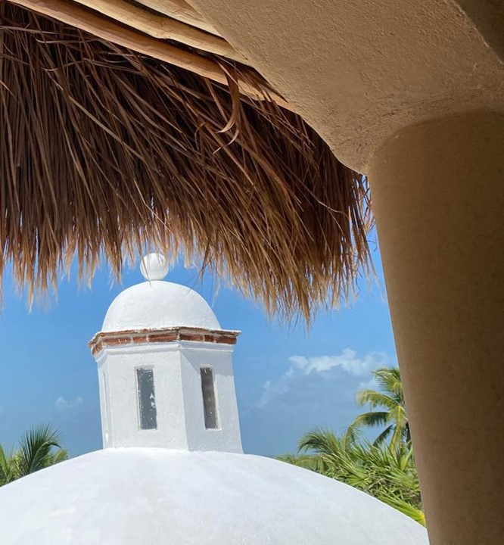
VALUE PROPOSITION
WFH EMPLOYEES

Slide 49
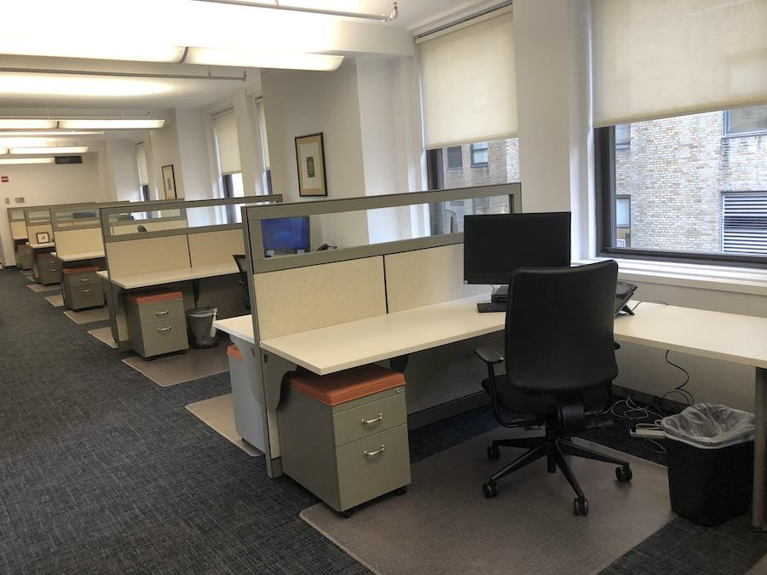
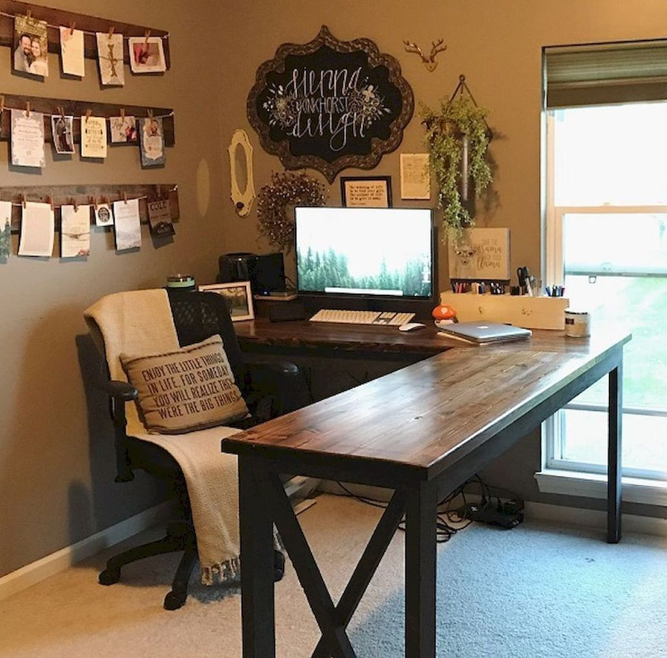
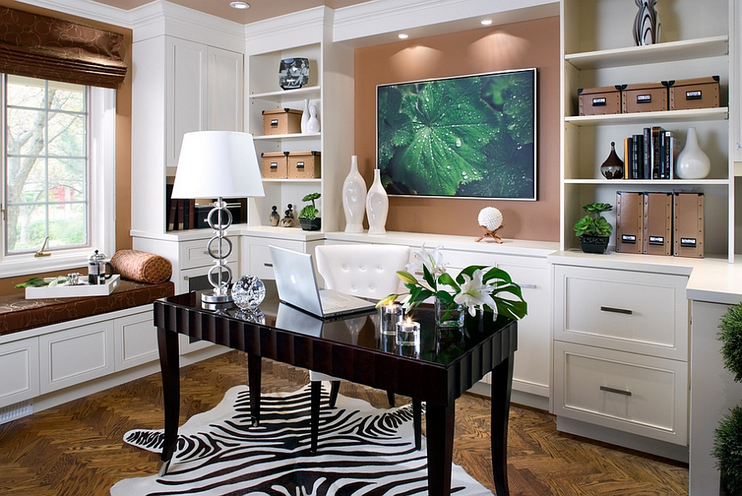
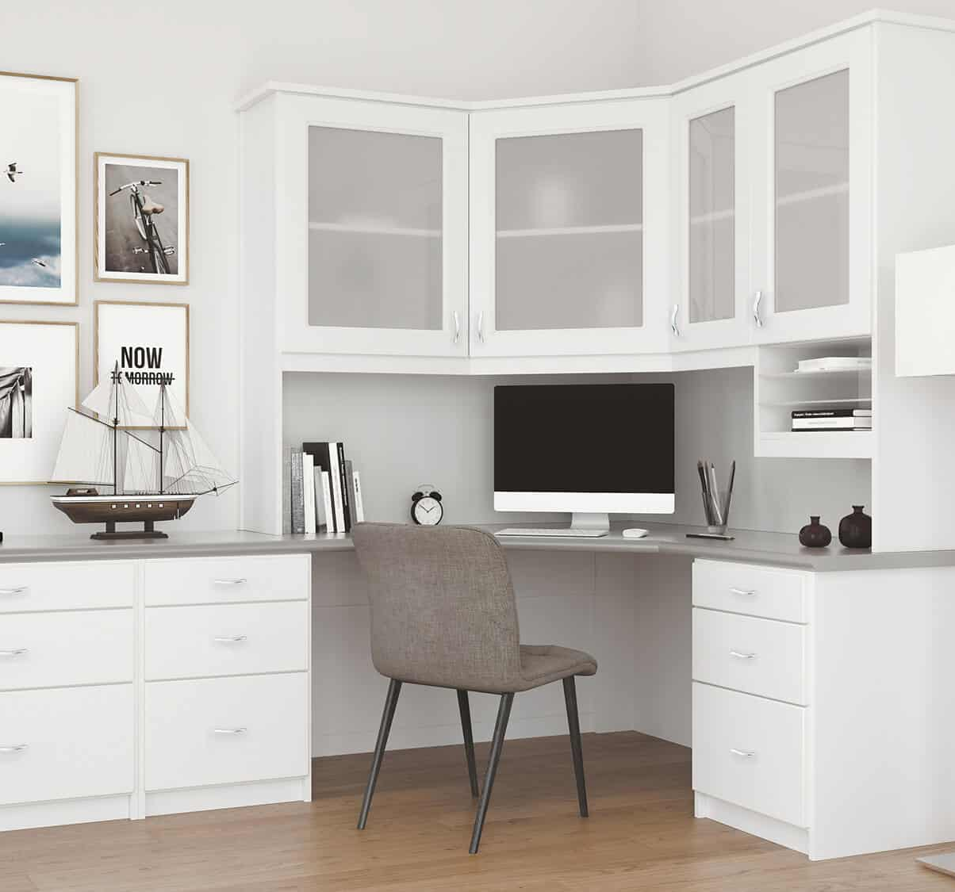
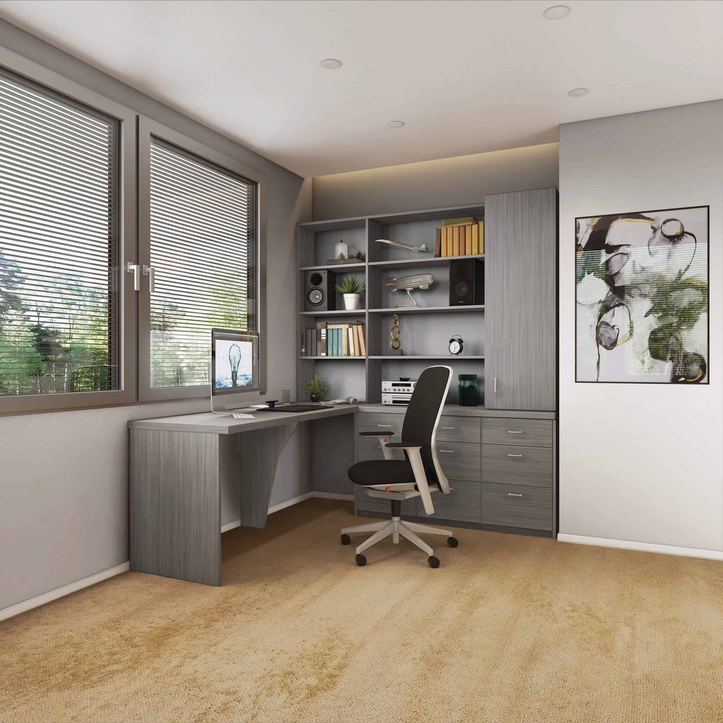

Slide 50
WHY NOW

